Slide 1
Introduction to Global Securities Market
国际证券市场简介
College of Software Technology, Zhejiang University
浙江大学软件学院
May 19-20, 2018
Edward Li, CFA, FRM
ecli_99@yahoo.com

Slide 2
Learning Objectives
Through this course the students will understand the fundamental concepts about Fixed Income Securities, Fixed Income Market and Trading flow. It will also help the students to learn how the Fixed Income market works in real world through examples and discussion.
One quiz will be given for this topic.

Slide 3
推荐教材或主要参考书
1.
Name:债券市场 分析和策略
Author: Frank J.Fabozzi
Publisher: 北京大学出版社
Language: English
Date: 2006-1
ISBN: 7-301-09657-7
2.
Name: 固定收入证券市场及其衍生产品
Author:Suresh M. Sundaresan
Publisher:北京大学出版社
Language: English
Date:
ISBN: 7-301-05963-9

Slide 4
The useful websites
Http://www.bondmarkets.com
  The Bond Market Association website contains very useful data concerning fixed-income markets, research reports, market practices, and regulator developments.
Http://www.bloomberg.com
  Excellent websites for financial news, fixed income data including yield curve, stock quotes, and interest rates.
Http://www.chinabond.com.cn
  China bond market website contain lots of China treasury bond, and corporate bond market data, research reports and regulator information.

Slide 5
Agenda
Fixed Income Overview
1. Fixed Income Concept and Key Terminologies
2. Fixed Income Securities
Fixed Income Market
3. Fixed Income Market Type and Characters
4. U.S. and China Fixed Income Market
Fixed Income Basic Pricing
5. Fixed Income Basic Pricing
6. Measure of Bond Price Volatility
Fixed Income Trading
7. Fixed Income Trading Process
8. U.S. Fixed Income Trading

Slide 6
Fixed Income Overview

Slide 7
Basic Characteristics of Bonds
Bond Parties
  The Issuer Who Is Borrowing Money
  The Investors Who Lend the Money
  A contract between an issuer and an investor
Maturity Date
  Is the day on which the issuer must pay the principal (face amount) of the bond to the investor
  The investor will also receive his last semiannual interest payment at this time
  Maturities typically vary from 10 years to as long as 100 years
Par Value
  Is the amount that the issuer agrees to pay the investor when the bond matures; also called the Principal or Face Amount
  Is Easily Traded in the Bond Market

Slide 8
Basic Characteristics of Bonds
Prices
  The price of a bond is usually stated as a percentage of its par value. For example, a bond with a price of 100 is selling for 100% of its par value or $1,000
  A bond with a price of 90 is selling at a discount equal to 90% of par value or $900 (90% X $1,000)
  A bond with a price of 110 is selling at a premium equivalent to 110% of its par value or $1,100 (110% X $1,000)
Coupon Rate
  Until the bond matures, the issuer agrees to pay the investor a stated amount of interest called the coupon rate (nominal yield)
  Set at the time the bond is issued and remains fixed for the life of the bond
  Stated interest rate multiplied by the bond’s par value: 10% bond; $100 (10% X $1,000)
  Bonds usually pay interest semiannually

Slide 9
Overview of Bond Features
Type of Issues – federal government, agencies, municipal government, and corporations.
Par Value – also know as “face value” which is the value return to the investor when the bond matures.
  bonds often trade above or below par. Buying below par is a discount, above par is premium.
Coupon rate – Interest rate that the bond issuer promises to pay to the bondholder.
  Fixed coupon bond
  Zero-coupon bond – makes zero coupon payments; investors receive par value at the maturity date, but receive no interest payments until then; typically issued at prices considerably below par value
  Floating-rate bonds (reference rate + quoted margin) : 3 month Libor + 20 Basic Points
Term to Maturity – Due date of the bond for repayment.
  Short term: bond with a maturity of between one and five years.
  Intermediate term: bond with a maturity between five and 12 years.
  Long term: bond with a maturity more than 12 years.

Slide 10
Overview of Bond Features
Amortization Feature – The principal repayment of a bond issue can call for the principal repaid over the life of the bond.
  Amortization Schedule: automobile loan and home mortgage loan.
Embedded Options
  Call provision – the issuer has right to retire the debt, fully or partially, before maturity.
  Put provision – the bondholder has the right to sell the issue back to the issuer at par value on designated dates.
  Convertible bond – the bondholder has right to exchange the bond for a specified number of shares of common stock.
  Exchangeable bond – bondholder to exchange the issue for a specified number of common stock shares of a corporate different from the issuer of bond.

Slide 11
Example
Use the following information to answer questions 1-3.
An investor purchased an 8% bond which matures in 10 years at 95.
1. How much did the investor pay for this bond?
  $9.95
  $95
  $950
  $9,500
2. This bond was purchased at a:
  Discount
  Premium
3. How much will the investor receive when the bond mature?
  $800
  $950
  $1,040
  $1,080

Slide 12
Example
A zero-coupon bond would be an appropriate investment for which of the following investors?
  A retired person who needs regular income to supplement social security
  Someone who needs a lump sum in 10 years to pay off the balloon mortgage on his house

Slide 13
Calculating Returns on Fixed-Income Securities
There are four ways to represent a bond’s yield:
  Nominal yield (the stated, fixed coupon)
  Current yield
  Yield to maturity
  Yield to call
Nominal Yield
  is the stated rate of interest that the issuer promises to pay the bondholder
  Fixed at issuance and will not change
Current Yield
  Measures the interest that the investor receives from the bond compared to its current market price
  Current Yield = Annual Interest Payment/Current Market Price

Slide 14
Calculating Returns on Fixed-Income Securities
Yield to Maturity
  Measures the investor’s total overall return
  Most widely quoted type of yield for bonds
  Represents the overall rate of return if the bond is purchased at today’s market price and held to maturity date and assumes the reinvestment and compounding of interest
Yield to Call
  Takes into account a bond’s cash flow through its first call date
  It is calculated the same way as yield to maturity, except that it reflects the bond’s interest payments until is called, rather than when it matures

Slide 15
Relation between coupon, yield and price
Coupon rate < required yield -> price <par (discount bond)
Coupon rate = required yield -> price = par
Coupon rate > required yield -> price > par (premium bond)
Premium Bond
Coupon Rate>Current Yield>Yield to Maturity
Discount Bond
Coupon Rate<Current Yield<Yield to Mat

Slide 16
Calculating Returns on Fixed-Income Securities
Use the following information to answer questions 1 through 3.
1. An investor purchased an 8% Lemon Country Bond at 80.
What is the bond’s nominal yield?
  6%
  8%
  9%
  10%
2. What is the bond’s current yield?
  6%
  8%
  9%
  10%
3. The yield to maturity will be:
  The same as the nominal and current yield
  Greater than the current yield
  Less than the current yield
  Less than both the current and nominal yields

Slide 17
Risks association with bonds
Interest Rate Risk
Reinvestment Risk
Call Risk
Credit Risk
Inflation Risk
Exchange-Rate Risk
Liquidity Risk
Volatility Risk

Slide 18
Risks association with bonds
Interest risk is the risk that a bond’s market price will decrease if interest rates increase.
Long-term bonds are more vulnerable to interest-rate risk than short-term bonds.
For a bond selling at a discount, the nominal yield (coupon) is less than the current yield, which is less than the yield to maturity
For a bond selling at a premium, the nominal yield (coupon) is more than the current yield, which is more than the yield to maturity
Which of the following securities is likely to decrease the most in price if interest rates rise?
  A bond maturing in 2 years
  A bond maturing in 15 years

Slide 19
Risks association with bonds
As interest rates increase, the value of existing bonds decreases; vice verse, as interests decrease, the value of existing bonds increases.
An investor recently invested $100,000 in bonds. What will happen to the value of his portfolio if interest rates increase?
  It will decrease
  It will remain the same
  It will increase
  It cannot be determined from the information given

Slide 20
Credit Risk
Credit risk is a major risk in purchasing fixed-income securities
It is the risk that the issuer may default and may not be able to meet its obligations to pay interest and principal to the bondholders

Slide 21
U.S. Treasury Securities
Issued by the U.S. Department of the Treasury and are backed by the full faith and credit of the U.S. government. Market participants view them as having no credit risk.
Interest rates on Treasury securities are benchmark interest rates throughout the U.S. economy.
Two factors : volume and liquidity.
Types of Treasury Securities
  Fixed-principal securities: Treasury bills, Treasury notes and Treasury bonds.
  Inflation-Indexed securities, also Treasury inflation protection securities (TIPS)
Stripped Treasury Securities
  STRIPS program.
  The zero-coupon Treasury securities created under the STRIPS program.

Slide 22
U.S. Treasury Securities
Treasury STRIPS do not pay interest periodically
T-bonds mature in more than 10 years, carrying high interest-rate risk
Jessica just received an inheritance from her Uncle Sam. She plans to use the money for a down payment on a house in six months, but she wants to earn some interest on the money in the meantime. Which of the following investments would suitable for her?
  Treasury bills
  Treasury STRIPS
  Treasury bonds
  Common stocks

Slide 23
U.S. Treasury Securities
Interest paid on U.S. Treasury securities is taxable at the federal level, but exempt from state and local income taxes
Treasury notes have initial maturities ranging from two to ten years
Treasury bonds are issued with maturities of more than 10 years
Price Quote
  As a percentage of their par value, in increments of 1/32nds of par
  Example, if a US government bond is quoted at 97.08, its price is equivalent to 97 8/32 (97.25% of $1,000 par value) or $972.50
  Note: Other bonds (e.g. corporate bonds) are quoted in increments of 1/8th.

Slide 24
U.S. Treasury Securities
Price Quote
A U.S. government bond is selling in the market at 98.08. The dollar value of this bond is:
  $980.25
  $980.80
  $982.50
  $9,808.00

Slide 25
U.S. Treasury Securities
Considered the safest type of fixed-income investment, suitable for the most conservative investors
The Treasury currently sells T-bills that mature in 4-week, 13-week, 26-week and 52-week maturities
It does not sell T-bills that mature in 2 years
All the following characteristics are true of Treasury bills EXCEPT:
  They are sold at a discount from their face value
  Investors can purchase T-Bills that mature in two years
  T-Bills are negotiable securities that trade in the secondary market
  They are direct obligations of the U.S. Treasury

Slide 26
Treasury Inflation Protection Securities
Inflation adjusted principal, for example:
A TIPS, coupon rate is 3.5%, annual inflation is 3%. An investor purchases on Jan 1 $100,000 par value of this issue.
The semiannual inflation rate is 1.5%.
The inflation-adjusted principal at the end of the first six-month period is
$100,000 * (1 + 1.5%) = $101,500.
The coupon payment is 101,500 * 1.75% = $1,776.25
An inflation-adjusted principal is defined in terms of the ratio of the reference CPI.

Slide 27
Corporate Securities
Corporate Bond Instruments:
  Corporate bond
  Medium-term notes
  Commercial paper
  Asset-backed securities
Corporate Bond
  Investment Grade
  High-Yield Debt.

Slide 28
Types of Corporate Bonds
Secured
  Mortgage Bonds: secured by a first or second mortgage on real property, giving the bondholders a lien on the property
  Equipment Trust Certificates: secured by a specific piece of equipment that is owned by the company and used in its business; usually issued by transportation companies (railroads, airlines, and shipping companies to finance new pieces of equipment
  Collateral Trust Bonds: secured by third-party securities owned by the issue; these securities are placed in escrow as collateral for the bonds
All debt issued by a corporation is backed by the full faith and credit of the issuer
Secured bonds are additionally backed by specific corporate assets

Slide 29
Corporate Bonds
Price Quote
Quoted in the market at a dollar price (percentage of par), in points and eights of a point
For example, a corporation bond is offered at 94 5/8. What is the cost for each $1,000 bond?
  5/8 = 0.625
  94 5/8 ->94.625->94.625%
  94.625% X $1,000 = $946.25

Slide 30
Types of Corporate Bonds
Unsecured
  Secured only by the corporation’s good faith and credit
  These unsecured securities are called notes and debentures
Debentures are:
  Unsecured corporate bonds
  Municipal bonds
  Mortgage bonds
  High-yield bonds

Slide 31
Convertible Bonds
Allow the investor to convert the bonds into shares of the company’s common stocks, at a predetermined ratio
The conversion price is set at the time the bond is issued
Conversion Ratio = Par Value of Bond/Conversion Price
Example, if ABC Company issues 10% convertible subordinated debentured with a conversion price of $40, the conversion)
Convertible bonds can be converted into:
  Subordinated debentures
  Common stock
  Equipment trust certificates
  Warrants

Slide 32
Convertible Bonds
XYZ convertible debentures are convertible into 20 shares of XYZ Corporation common stock. If the bonds were selling in the market at $980, what would the common stock have to be selling at to be at parity?
  $20
  $45
  $49
  $50

Slide 33
Convertible Bonds
Arbitrage
  A technique that involves profiting from price differentials in the same or similar security
  These are the times when the market price of the convertible bonds does not reflect the value of the common stock that would be received if the bond were converted into stock
A technique used to profit from price differentials in the same security is known as:
  Arbitrage
  Dilution
  Forced conversion
  Tender offer

Slide 34
Retirement Methods
Redemption at Maturity
Earlier Redemption through a “Call”
  Interest Rates Have Declined and Issuer Wants to Refinance
Refunding Funds
  Replace an old bond issue with a new one, often at a lower interest cost.
Sinking Funds
  a Plan to Retire A Portion of the Outstanding Bonds Each Year
Conversion to Common Stock
  Convertible Bonds

Slide 35
Credit Assessment
Most corporate bonds are given a credit rating by S&P, and Moody and Fitch Rating Service.
Bonds rated BBB or higher by S&P, Baa or higher by moody’s, are considered investment-grade bonds.
Bonds rated below these levels are considered to be high yield bonds.

Slide 36
Corporate Bond Rating
Moody’s S&P Fitch Brief Definition
Aaa AAA AAA Gilt edge, prime, maximum safety
Aa1 AA+ AA+
Aa2 AA AA Very high grade, high quality
Aa3 AA- AA-
A1 A+ A+
A2 A A Upper medium grade
A3 A- A-
Baa1 BBB+ BBB+
Baa2 BBB BBB Lower medium grade
Baa3 BBB- BBB-
Ba1 BB+ BB+
Ba2 BB BB
Ba3 BB- BB-
B1 B+ B+
B2 B B
B3 B- B-

Slide 37
Corporate Bond Rating
Securities that are rated Aaa to Baa or AAA to BBB are called Investment Grade securities and are suitable for most investors
Ba or BB and blow are considered speculative
The lower the rating, the greater the chance of default
Bonds that are rated below Baa or BBB are also known as high-yield or junk bonds
Bonds that are rated BB or below are called:
  Short-term bonds
  Zero-coupon bonds
  High-yield bonds
  Callable bonds

Slide 38
Corporate Bond Rating
Rating organizations are primarily concerned with the risk of default.
A high rating indicates a low risk of default
Rating organizations are primarily concerned with the risk of:
  Declining purchasing power
  Market price fluctuation
  Default
  Illiquidity

Slide 39
Call Provisions
A provision that allows the issuer, at its option, to redeem the bonds before they are due to mature
The investor receives the principal in full plus any accrued interest; any future interest payments stop
Call provision usually benefit the issuer, which has the option of calling in the bonds when interest rates decline
Call Risk
  Once called, the bondholders are unlikely to be able to reinvest their money for the same return that they were previously receiving unless they are prepared to increase the level of credit risk
Call Protection
  To protect investors, callable bonds often contain a restriction on how soon the call feature can be exercised, typically 5 to 10 years from the date of issue

Slide 40
Call Provisions
Call Premium
  For callable bonds, the issuer will usually need to pay the investors more than the par value of the bonds in order to compensate them for the call risk
  This is known as a call premium
A bond is purchased that is callable at 105 in five years. How much will the investor receive if the bond id called after five years?
  $800
  $950
  $1,000
  $1,050

Slide 41
Call Premium
The amount of money that the issuer must pay the owner of the bond when the bond is called
The amount is above the par value of the bond
Issuers usually call outstanding bonds when interest rates have dropped and they are able to issue new bonds at lower rates of interest
The call premium of a bond refers to the amount:
  An investor must pay to buy a callable bond
  The issue must pay to exercise the call privilege
  The issuer must add to the semiannual interest payments to offset the call feature
  Added to the price at issuance to compensate for the call privilege

Slide 42
Agency Securities
Debt instruments issued both by federal agencies and by government-sponsored enterprises
Not direct obligations of the U.S. government
Securities issued by federal agencies are backed by the full faith an credit of the U.S. government (e.g. Government National Mortgage Association)
Government-sponsored enterprise securities are NOT backed by the U.S. government. However, their default risk is considered to be minimal
Low credit risk

Slide 43
Agency Securities
Some examples of government-sponsored enterprise are:
  Federal Farm Credit Banks (FFCBs)
  Federal Home Loan Banks (FHLBs)
  Student Loan Marketing Association (SLMA or Sallie Mae)
All the following securities are backed by the U.S. government EXCEPT:
  Government National Mortgage Association Certificates
  Treasury bills
  Student Loan Marketing Association certificates
  Treasury bonds

Slide 44
Municipal Securities
Municipal securities are issued by state and local governments.
Most municipal bonds outstanding are tax-exempt for interest payments.
Types and Features of Municipal Securities
  General Obligation Bonds is secured by the issuer’s unlimited taxing power
  Revenue Bonds is secured by the revenue of issuers, such as Airport Revenue Bonds, University Revenue Bonds, Hospital Revenue Bonds, Public Power Revenue Bonds.

Slide 45
Asset-Backed Securities
Asset-backed securities (ABS) are bonds or notes collateralized by the cash flows from a specified pool of underlying assets.
The financial institutions that originate the loans sell a pool of cash-flow-producing assets to a specially created third party that is called a special-purpose vehicle (SPV). The SPV sells the pools loans to a trust, which issues interest-bearing securities that can achieve a credit rating separate from the financial institution that originates the loan.

Slide 46
Types of Asset-Backed Securities
Home Equity Loans
Autos
Credit Cards
Student Loans
Stranded Cost Utilities

Slide 47
Mortgage Backed Securities
A MBS is an instrument whose cash flow depends on the cash flows of an underlying pool of mortgages such as the purchase of homes or other real estate.
Three types of MBS:
  Mortgage pass-through securities
  Collateralized Mortgage obligations
  Stripped mortgage-backed securities
Key Associations
  Government National Mortgage Association (GNMA) backed by the National Housing Act 1970 – Ginnie Mac
  Federal National Mortgage Association (FNMA) - Fannie Mae (房利美)
  Federal Home Loan Mortgage Corporation (FHLMC) – Freddie Mac (房地美)

Slide 48
Types of Mortgage-Backed Securities
Pass-through securities
  The bondholder normally receives some portion of the bond’s principal and interest back each month, and may receive additional cash flow from prepayments.
Collateralized Mortgage Obligations (CMOs)
  Allow for the creation of bonds with a wide range of risk and return characteristics.
  Sequentials
  PACs (Planned Amortization Class)
  TACs (Targeted Amortization Class)
Stripped Mortgage-back securities

Slide 49
Types of Mortgage-Backed Securities
Pass-through certificates
  The most common security issued by government agencies
  To create a pass-through certificate, the agency purchases a pool of mortgages
  Interests in the pool are sold to investors as pass-through certificates
  Each certificate represents an undivided interest in the pool, which entitles the owner to a share in the cash flow generated by the pooled mortgages
  The pass-through payment includes interest and principal
  Fully negotiable
  Investors may sell tem to other investors after they are issued

Slide 50
Types of Mortgage-Backed Securities
Pass-through certificates
Monthly payments from GNMA pass-through certificates represent:
  Interest
  Principal
  Interest and Principal
  The performance of the mortgage pool

Slide 51
Types of Mortgage-Backed Securities
Pass-through certificates
  Would provide investors with a monthly income
Treasury STRIPS are a form of zero-coupon bonds that do not pay any income until they mature
Treasury notes pay interest twice a year
Common stock do not always pay dividends and, if they d, they are usually paid quarterly
Which of the following securities would you recommend to investors who need monthly income?
  Treasury STRIPS
  GNMA pass-through certificates
  Treasury notes
  Common stocks

Slide 52
Money-Market Securities
Short-term debt securities (one year or less)
Issuers include the US government, government agencies, banks, and corporations
Borrowing and lending periods range from overnight to a few months, but may be as long as one year
Examples
  Commercial Paper
  Bankers’ Acceptances
  Negotiable Certificates of Deposit
  Federal Funds
  Money-Market Funds
  Repurchase Agreements (Repos)

Slide 53
Money-Market Securities
Commercial Paper
  For short-term financing, unsecured corporate debt
  Matures in 270 days or less
  Issued at a discount
  Usually issued by corporations with high credit ratings and it’s considered very safe
  The minimum denomination is typically $100,000
Bankers’ Acceptance
  Used to facilitate foreign trade
  Actively traded and are considered quite safe since they are secured both by the issuing bank and by the goods originally purchased by the importer

Slide 54
Money-Market Securities
Short-term money-market instruments guaranteed (accepted) by a bank or trust company in order to provide manufacturers and exporters with capital to operate and which are traded in the secondary market at prices that are discounted from the face value are:
  Certificates of deposit
  Bankers’ acceptances
  Commercial paper
  ADRs

Slide 55
Concept of Securitization
Originator 1
Pool of mortgages
Originator 2
Credit and liquidity
Enhancements (guarantees)
Originator 3
Special Purpose
Vehicle
Credit rating agencies
(issuance of high credit)
MBS
Financial
Intermediaries
Institutional and
retail Investors

Slide 56
Fixed Income Market

Slide 57
Fixed Income Market Type
Money market
  defined as the market for financial assets that have original maturities of one year or less.
Bond market
  Is as the market for fixed income security that have maturities of more than one year.

Slide 58
Fixed Income Market
From issuers perspective, we can get six sectors:
Government sector
  Include Treasury bills, notes, and bonds, plays a key role in the valuation of securities and the determination of interest rates.
Agency sector
Municipal sector
  State and local government issue bonds.
Corporate sector
Asset-Backed sector
Mortgage Sector

Slide 59
Market Organization
Direct Search
  An arrangement in which buyers directly search and identify matching sellers without the benefit of one or more intermediaries.
Brokered Market
  When trading becomes more and more frequent, brokers may find it economical to intermediate ( for a fee) and match buyers and sellers at mutually agreed-upon terms.
Dealer Market
  Dealers may quote different bid-offer prices from the same security.
  Dealers, unlike brokers, also take outright positions in securities.
  Dealers are also exposed to the market risk on their investories.
Auction Market
  Centralized markets in which all market participants interact simultaneously

Slide 60
The Player in Bond Market
Issuer of Bond Securities
Financial Intermediaries
Institution and Retail
Investors
Issuer:
Government and Agency
Corporate
Commercial Bank
States
Special-purpose Vehicals
Foreign Institutions
Issuer:
Primary Dealers
Other Dealers
Investment Bank
Credit Rate Agencies
Credit and liquidity
enhancer
Issuer:
Government
Pension fund
Insurance companies
Mutual fund
Commercial Bank
Household

Slide 61
U.S. Treasury Market
Maturities ranging from a few days to 30 years.
The Treasury securities are auctioned by the U.S. Treasury frequently. (Buyback)
On-the-run issues & Off-the-run issues
Their prices are quoted in fractions of 1/32,1/64. (1/32 is referred to as a tick)
The flat price(the quoted price) plus the accrued interest is known as the full price or the invoice price.
Benchmark Maturities – 3m,6m,1Y,2Y,5Y,10Y,30Y

Slide 62
Corporate Bond Market
Two key differences between the Treasury and corporate market
  Credit risk
    Moody’s, Standard & Poors, and Fitch.
  Smaller issues
    A typical corporate issue is of the order of $100 million to $200 million, whereas a typical Treasury auction is of the order of $10 billion to $12 billion.
Key corporate securities
  Price the new issues
  Arrange the distribution
  Call or sink features
Trading
  A small number of bonds on NYSE
  A substantial percentage in the dealer market
Price transparency in Corporate bond Market
  Small, varying credit quality, tremendously contractual features, illiquid
  TRACE

Slide 63
Corporate Bond Market
TRACE (Trade Reporting and Compliance Engine)
  NASD members report over-the-counter ("OTC") secondary market transactions to NASD
  increased price transparency in corporate bonds.
  On January 23, 2001, SEC approved
TRACE Corporate Bond Data
  Daily Report
    http://apps.nasd.com/regulatory%5Fsystems/traceaggregates/nasd/
  Search Corporate Bond Trading
    http://www.nasdbondinfo.com/asp/bond_search.asp

Slide 64
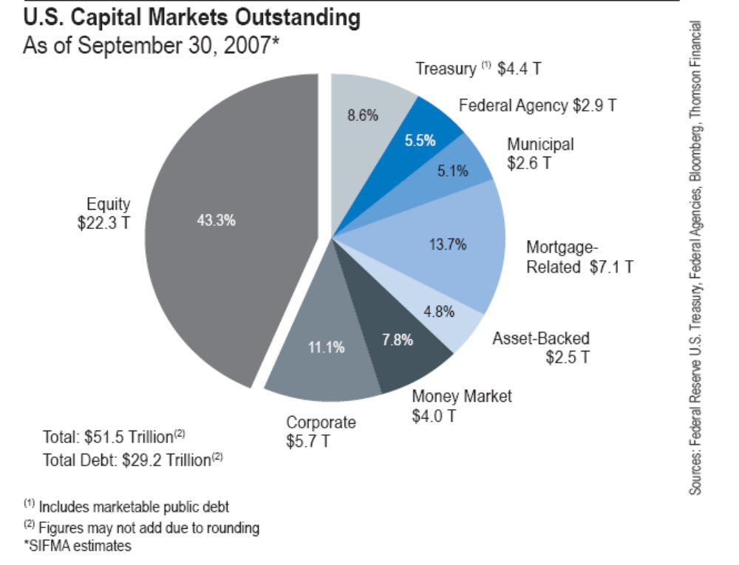
U.S. Bond Market

Slide 65
Mortgage-backed Market
每月归还贷款
出售资产抵押债券
出售房地产债务抵押证券CDO）
Prime
Alt-A
Sub
prime
次
级
抵
押
贷
款
公
司
房地产抵押债券支持证券（MBS）
投
资
银
行
对冲基金
保险公司
养老基金
银 行
提供住房贷款
提供贷款现金
提供资金

Slide 66
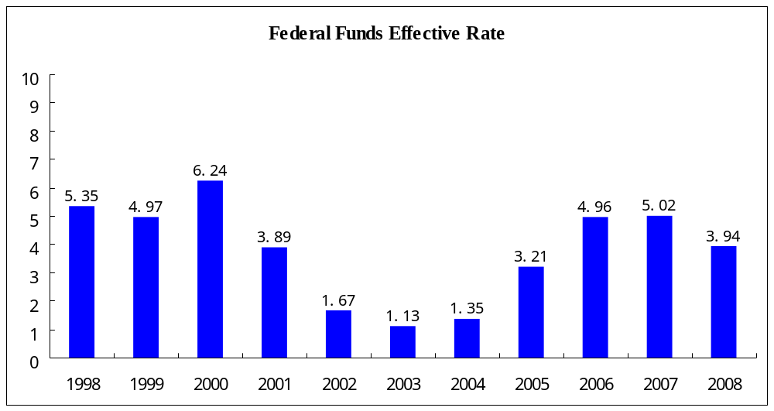
Federal Fund Interest Rate

Slide 67
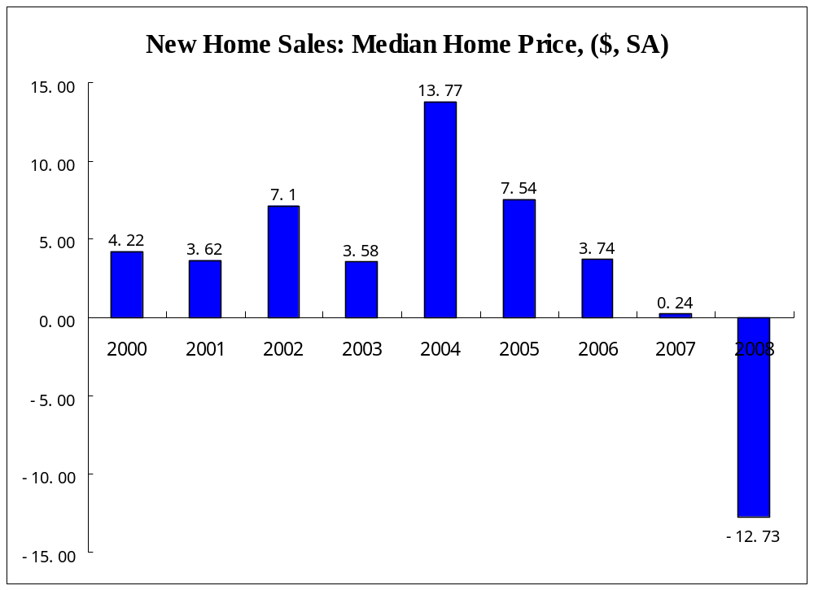
U.S. House Price Fall

Slide 68
Fixed Income Basic Pricing

Slide 69
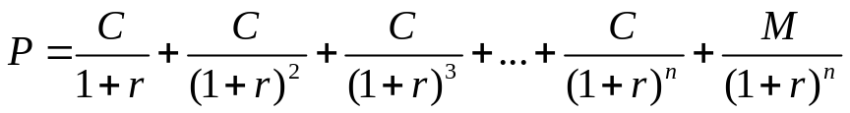
Price of Bonds
An estimate of the expected cash flow
  Periodic coupon interest payments to maturity date
  The par (or maturity) value at maturity
An estimate of the appropriate required yield
  The required yield is determined by investigating the yield offered on comparable bonds in market.
The formula:
  P is the bond price
  C is the periodic coupon payment
  N is the number of years to maturity
  M is the (face value) payment at maturity
  r is the “risk-adjusted discount rate” (or yield to maturity, or IRR)

Slide 70
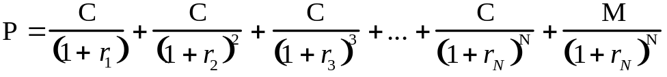
But what if interest rates differ over time?
You can still calculate a YTM (y)
But it is a complex average of spot rates
Here, each spot rate r_{n} is the discount rate for a cash flow in year n that can be locked in today
E.g., r₃ (3-year spot rate) is the rate the market uses to value a single payment three years from today

Slide 71

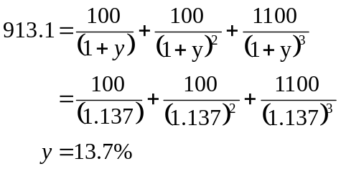
Coupon bond example
Take a 3-year 10% coupon bond with face value = 1000, assuming annual coupon payments:
  Spot rates: r₁=10%, r₂=12%, r₃=14%
  Yield-to-Maturity

Slide 72

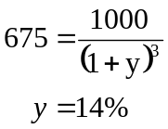
Zero coupon bond example
Price of 3-year zero coupon bond with face value = 1000
  Spot rates: r₁=10%, r₂=12%, r₃=14%
  Yield-to-Maturity

Slide 73
Forward Rates
Forward rates of interest are implicit in the term structure of interest rates
t = 0 1 2 3 4…
Note the notation: ₃f₄ means “the forward rate from period 3 to period 4.”
When the beginning subscript is omitted, it is understood that the forward rate is for one period only: ₃f₄ = f₄ .
r₁
₁f₂
r₂
₂f₃
r₃
₃f₄

Slide 74
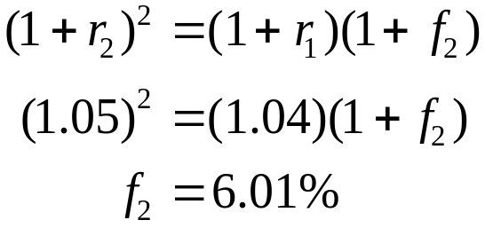
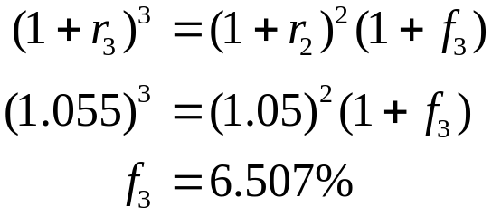
Example: Forward rates
What one-year forward rates are implied by the following spot rates?
Maturity Year | Spot Rate (r_{t}) | Forward Rate (f_{t})
1 | 4.0% | –
2 | 5.0% | 6.01%
3 | 5.5% | 6.507%

Slide 75
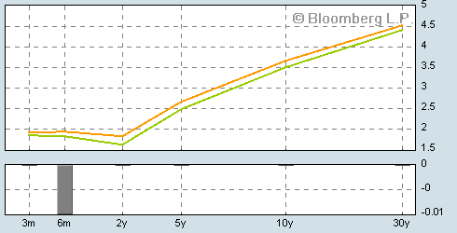
The term structure of interest rates

Slide 76
Bond prices and spot rates
From bond prices to spot rates
*Coupons are paid semi-annually.
Face Value | Times to Maturity | Annual coupon | Bond Price
100 | 0.5 | 0 | 95.02
100 | 1.0 | 0 | 90.09
100 | 1.5 | 8 | 96.04

Slide 77
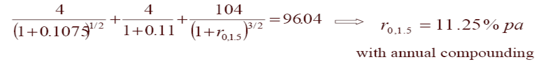
Bond prices and spot rates
6-month spot rate:
1-year spot rate:
1.5-year spot rate:

Slide 78
Price-Yield Relationship
The price changes in the opposite direction from the change in the required yield. This shape is referred to as convex.
Price
Yield

Slide 79
Relation between coupon, yield and price
Coupon rate < required yield -> price <par (discount bond)
Coupon rate = required yield -> price = par
Coupon rate > required yield -> price > par (premium bond)

Slide 80
Relationship between Bond price and Time if interest rates are unchanged
The price will move to par value at the maturity date.
For example: a 20-year 10% coupon bond.
Year | Price of Discount Bond Selling to Yield 12% | Price of Premium Bond Selling to Yield 7.8%
20 | 849.54 | 1,221.00
15 | 862.35 | 1,192.54
10 | 885.30 | 1,150.83
5 | 926.40 | 1,089.67
3 | 950.83 | 1,057.85
2 | 965.35 | 1,040.02
1 | 981.67 | 1,020.78
0 | 1,000.00 | 1,000.00

Slide 81
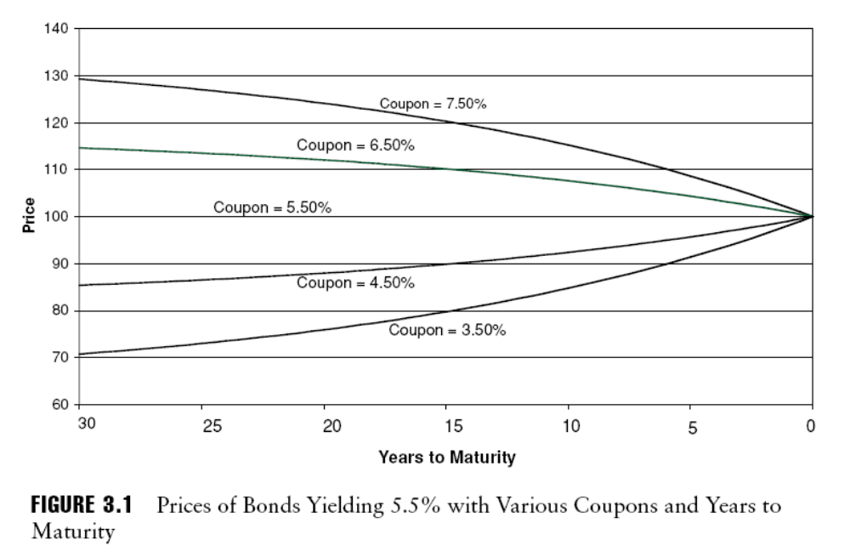
Relationship between Bond price and Time if interest rates are unchanged

Slide 82
Yield of Bond
The general definition of yield is the return an investor will receive by holding a bond to maturity.
Current Yield calculates the percentage return that the annual coupon payment provides the investor.
Annual Interest Paid
Current Yield = *100%
Market Price
If you purchased a bond with a par value of %100 for $95.92 and it paid a coupon rate of 5%, the current yield is
(0.05*$100)
= * 100% = 5.21%
%95.92

Slide 83
Yield of Maturity
Yield to Maturity is the return that the investor will receive of all cash flows at a constant interest rate until the bond matures.
Cashflow1 Cashflow2 Last C
Bond Price = + +…+
(1+yield)1 (1+yield)2 (1+yield)n
The yield to maturity is a interest rate that must be calculated through trial and error.

Slide 84
Measures of Bond Price Volatility
Duration is a measure of price sensitivity to interest rates—that is, how much a bond’s price changes in response to a change in interest rates.
Long-term bonds are more sensitive to interest rate movements than are short-term bonds
Macaulay duration
Modified duration
Effective duration
How to calculate a duration? – basic process

Slide 85
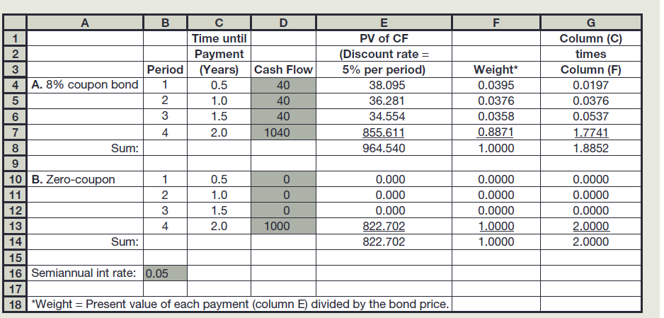
How to calculate the duration? A example
A 8% coupon bond with 2 years to maturity

Slide 86
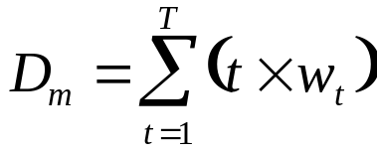
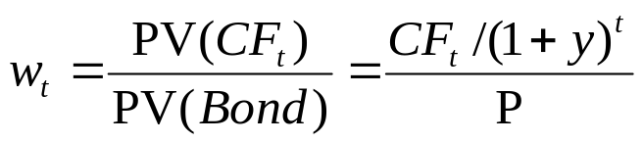
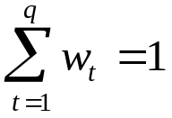
I. (Macaulay) duration
Weighted average term to maturity
  Measure of average maturity of the bond’s promised cash flows
Duration formula:
where:
t is measured in years

Slide 87
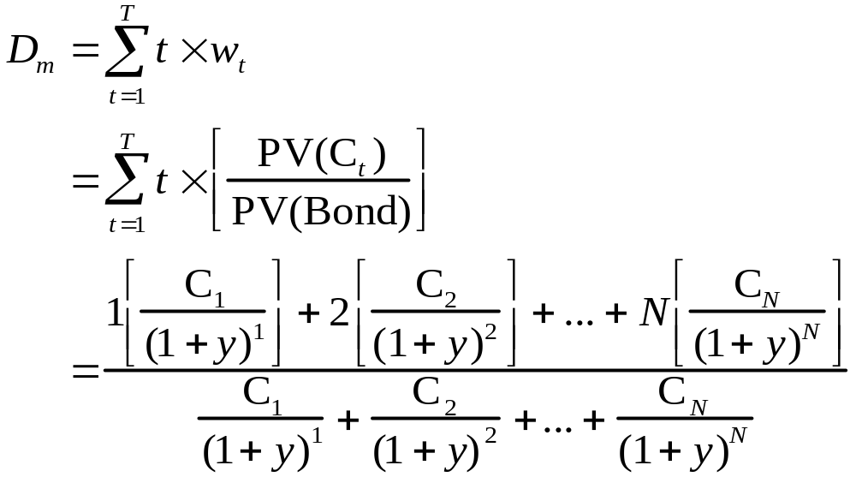
Duration - The expanded equation
Duration is shorter than maturity for all bonds except zero coupon bonds
Duration of a zero-coupon bond is equal to its maturity

Slide 88
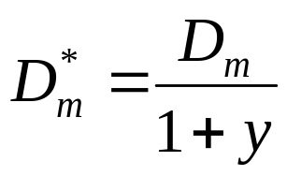
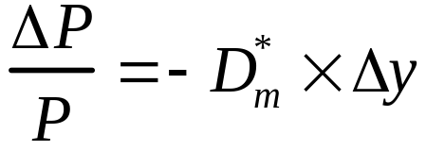
II. Modified duration (D*_{m})
  Direct measure of price sensitivity to interest rate changes
  Can be used to estimate percentage price volatility of a bond

Slide 89
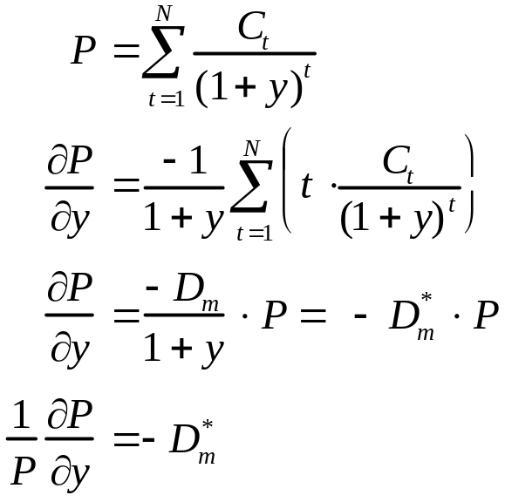
Derivation of modified duration
So D*_{m} measures the sensitivity of the % change in bond price to changes in yield

Slide 90
III. An example
Compare the price sensitivities of:
  Two-year 8% coupon bond with duration of 1.8853 years
  Zero-coupon bond with maturity AND duration of 1.8853 years
Semiannual yield = 5%
Suppose yield increases by 1 basis point to 5.01%
Upshot: Equal duration assets are equally sensitive to interest rate movements
 | Original Price | New Price | % Change
Coupon bond | 964.54 | 964.19 | -.0189
Zero bond | 831.96 | 831.61 | -.0189

Slide 91
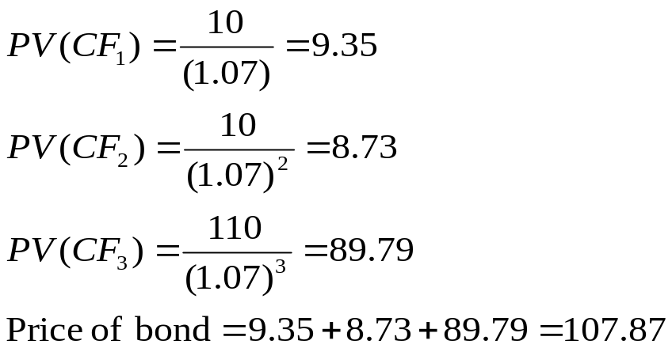
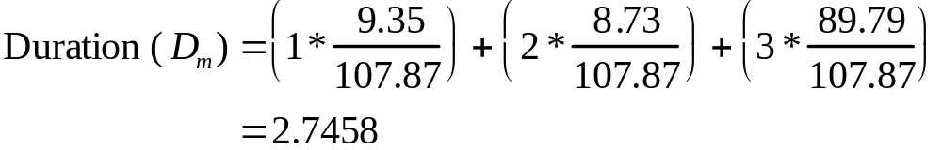
Another example
Consider a 3-year 10% coupon bond selling at $107.87 to yield 7%. Coupon payments are made annually.

Slide 92
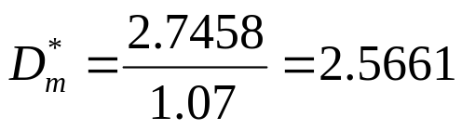
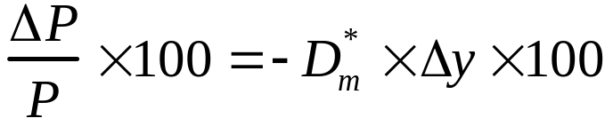
Another example – page 2
Modified duration of this bond:
If yields increase to 7.10%, how does the bond price change?
The percentage price change of this bond is given by:
= –2.5661 × .0010 × 100
= –.2566

Slide 93
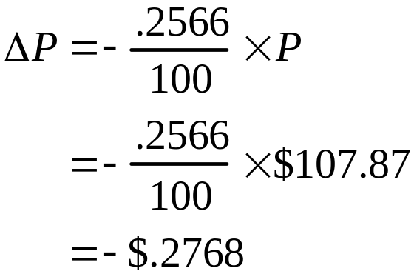
Another example – page 3
What is the predicted change in dollar terms?
New predicted price: $107.87 – .2768 = $107.5932
Actual dollar price (using PV equation): $107.5966
Good
approximation!

Slide 94
Duration – Basic Rules
The duration of a zero-coupon bond equals its time to maturity
Holding maturity constant, a bond’s duration is higher when the coupon rate is lower
Holding the coupon rate constant, a bond’s duration generally increases with its time to maturity
Holding other factors constant, the duration of a coupon bond is higher when the bond’s yield to maturity is lower
The duration of a level perpetuity is (1+y)/y. For example, at a 10% yield, the duration of a perpetuity that pays $100 once a year forever will equal 1.10/0.10 = 11 years, but at an 8% yield it will equal 1.08/0.08 = 13.5 years

Slide 95
Duration – Basic Rules
Bonds with a high duration will have a higher price fluctuation than bonds with a low duration.
Three factors determine how sensitive a bond’s price is to changes in interest rate, term to maturity, coupon rate and yield to maturity.

Slide 96
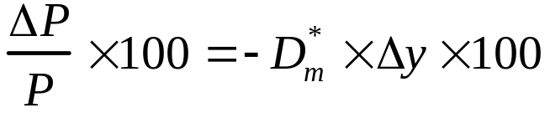
Summary: Steps for finding the predicted price change
Step 1: Find Macaulay duration of bond.
Step 2: Find modified duration of bond.
Step 3: Recall that when interest rates change, the change in a bond’s price can be related to the change in yield according to the rule:
  Find percentage price change of bond
  Find predicted dollar price change in bond
  Add predicted dollar price change to original price of bond
  ⇒ Predicted new price of bond

Slide 97
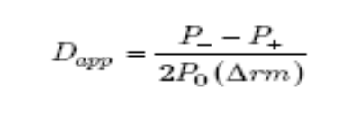
Effective Duration
The modified duration of a bond measures its price sensitivity to a change in yield. It assumes that no change in expected cash flows will result from a change in market interest rates and is thus inappropriate as a measure of the interest rate risk borne by a mortgage-backed bond, whose cash flows are affected by rate changes because of the prepayment effect.
A more accurate measure of mortgage-based bonds’ interest rate sensitivity is effective duration. Effective duration is based on approximate duration.
Where
P0 = the initial price of the bond
Δrm = the change in the yield of the bond
P– = the estimated price of the bond if the yield decreases by Δrm
P+ = the estimated price of the bond if the yield increases by Δrm
P– and P+ are obtained using a valuation model—such as a static cash flow model, a binomial model, or a simulation model—that incorporates the effect of a change in interest rates on the expected cash flows.

Slide 98
IV. Why is duration a big deal?
Simple summary statistic of effective average maturity
Measures sensitivity of bond price to interest rate changes
  Measure of bond price volatility
  Measure of interest-rate risk
Useful in the management of risk
  You can match the duration of assets and liabilities
  Or hedge the interest rate sensitivity of an investment

Slide 99
Fixed Income Trading

Slide 100
Fixed Income Trading
Unregulated Market
Liquidity
Portfolio Diversification
Over the Counter
Institutional Dealers
Government Bonds / Treasury Bills
Fixed Income Mutual Fund

Slide 101
Trading for Fixed Income Securities
For treasury securities, the secondary market is an over-the-counter market in which a group of U.S. government dealers offer continuous bid and ask prices on outstanding treasuries.
Treasury Securities:
  On-the-run issues : newly auctioned treasury securities, bid-offer spread are typically 1/32 to 2/32.
  Off-the-run issues : the seasoned issues in previous auctions.
Treasury bills (T-Bills) are auctioned by the U.S. Treasury at periodic intervals. T-bills are among the most liquid and nominally riskless securities.
One of the most active and liquid markets in the world; it’s an easy place to buy into or get out of because bid-ask spreads are very narrow

Slide 102
Corporate bond trading
For corporation bonds, the principal secondary market is the over-the-counter market. There is some trading on exchanges
The price quota of investment-grade corporate bond trading is based on the benchmark plus spread.
The price quota of high yield corporate bond trading is based on price.

